Slide 1


Icebreaker Sparrows
Ashwin Mohite
Praveen Karande
Lalit Kumar
Theme: AI-Driven Recommendation Engine
Date: 18th June, 2025

Slide 2
PROBLEM STATEMENT & BUSINESS RELEVANCE
What is the problem you're solving?
Retail and distribution businesses often struggle to recommend the right products to dealers, leading to missed sales opportunities and inefficient inventory management.
Which industry vertical does this challenge belong to?
Retail, Distribution, and Supply Chain (focus on building materials like plumbing, sanitary, and water storage).
Who is the end user, and why does it matter?
End Users: Dealers (retailers, wholesalers, distributors) who purchase products like pipes, water storage, and tiles.
Why It Matters: Personalized recommendations increase sales, optimize inventory, and enhance dealer satisfaction by suggesting products based on purchase history and peer behavior, improving business efficiency and profitability.

Slide 3
SOLUTION OVERVIEW & CREATIVE APPROACH
How does your solution align with the assigned theme?
The solution delivers a scalable, data-driven recommendation system using Snowflake’s cloud platform and Streamlit interactive dashboards, aligning with the theme of leveraging modern data tools for business insights.
What does your solution do?
Generates synthetic dealer and product data in Snowflake.
Preprocesses data to create a recommendation input dataset.
Uses collaborative filtering (user-user and item-item) to recommend products to dealers.
Visualizes recommendations via a Streamlit dashboard with filters for region, dealer, and top-N products.
What’s unique or innovative about your approach?
Combines user-user and item-item collaborative filtering in Snowflake for robust recommendations.
Leverages Snowflake’s Snowpark for scalable data processing and Streamlit for real-time, interactive visualization.
Incorporates peer influence (other dealer’s purchases) to enhance recommendation relevance.

Slide 4
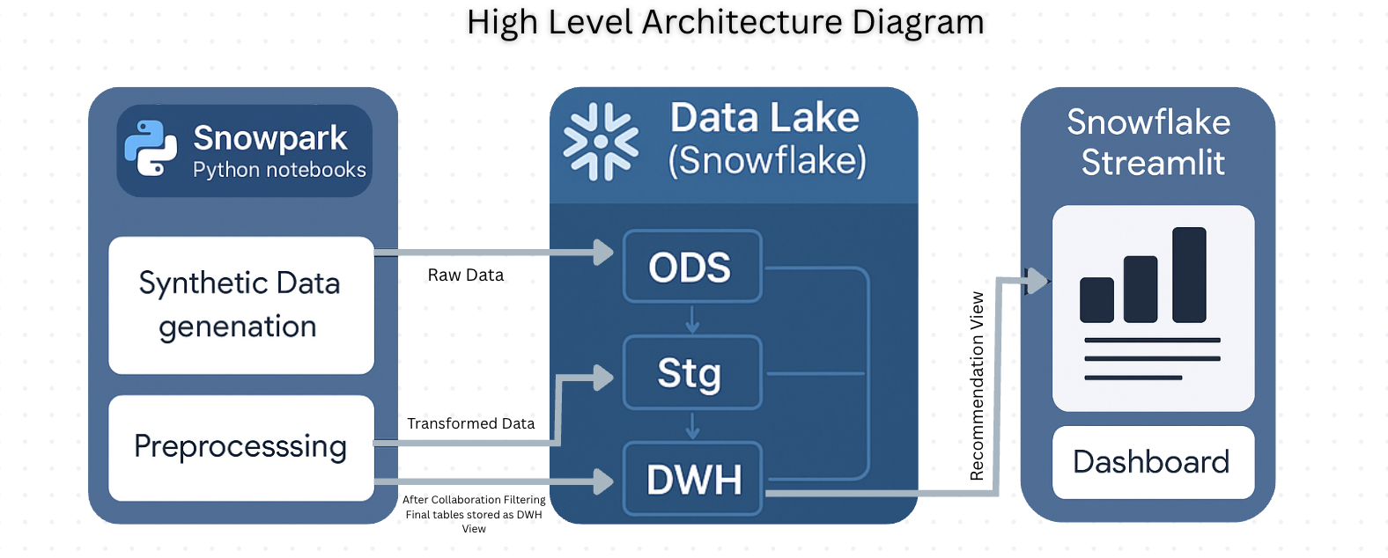
ARCHITECTURE
High-level architecture diagram

Slide 5
USE OF SNOWFLAKE
Key Snowflake Features Used
Snowpark: Python-based data processing for synthetic data generation and preprocessing.​
SQL Queries: Efficient joins, aggregations, and pivoting for collaborative filtering.​
Schemas (ODS, STG, DWH): Organized data pipeline for raw, staged, and transformed data.​
Views: DWH.RECOMMENDATION_DASHBOARD view for streamlined dashboard queries.​
Temporary Tables: For Optimize collaborative filtering computations.

Slide 6
USE OF SNOWFLAKE
Why was this setup chosen? Is it scalable?
Why Chosen: Snowflake’s cloud scalability handles large datasets, Snowpark enables Python-based ML workflows, and Streamlit provides user-friendly visualization.
Scalability: Snowflake’s elastic compute and storage, combined with batch processing in Snowpark, ensure scalability for growing dealer and product data. Temporary tables reduce memory overhead in collaborative filtering.

Slide 7
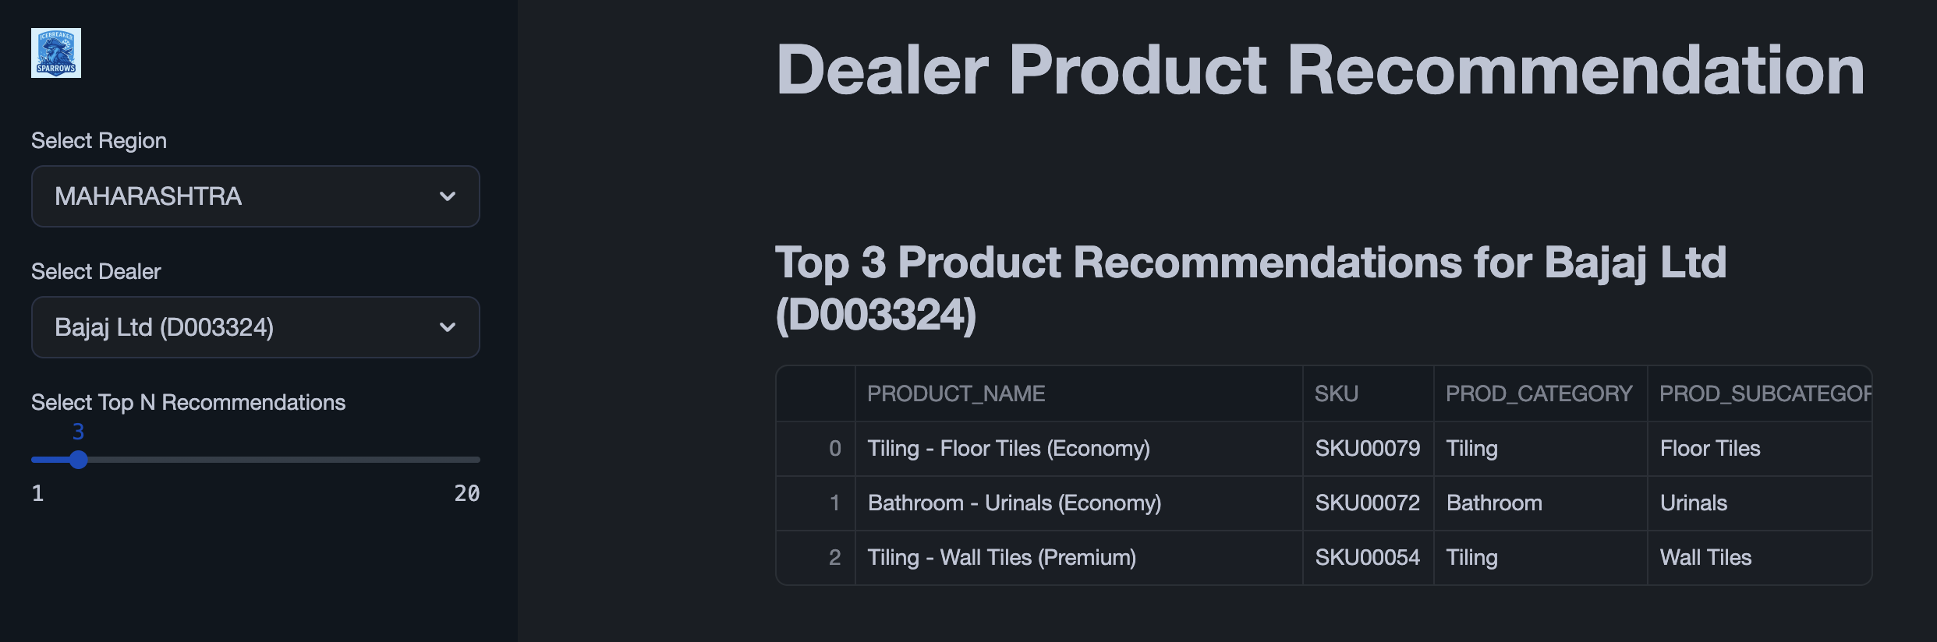
WORKING DEMO / OUTPUT
Link to demo video
Screenshots

Slide 8
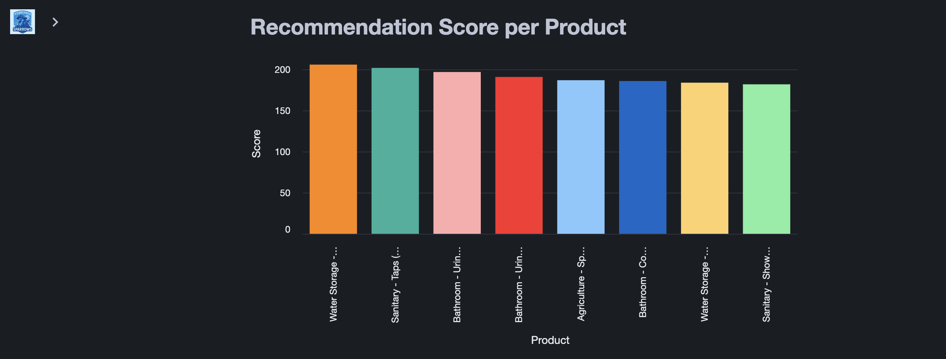
WORKING DEMO / OUTPUT
Screenshots

Slide 9
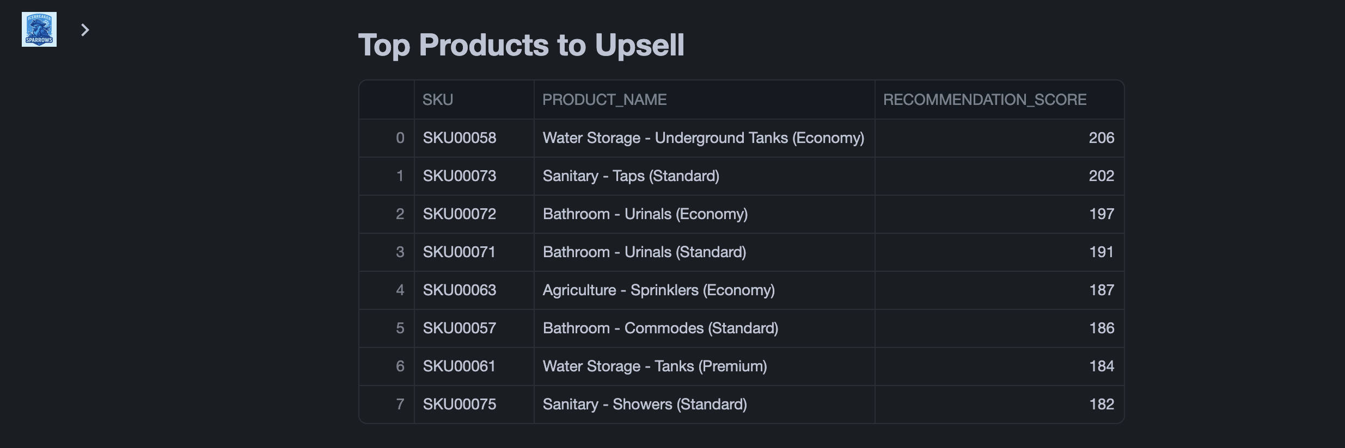
WORKING DEMO / OUTPUT
Screenshots

Slide 10
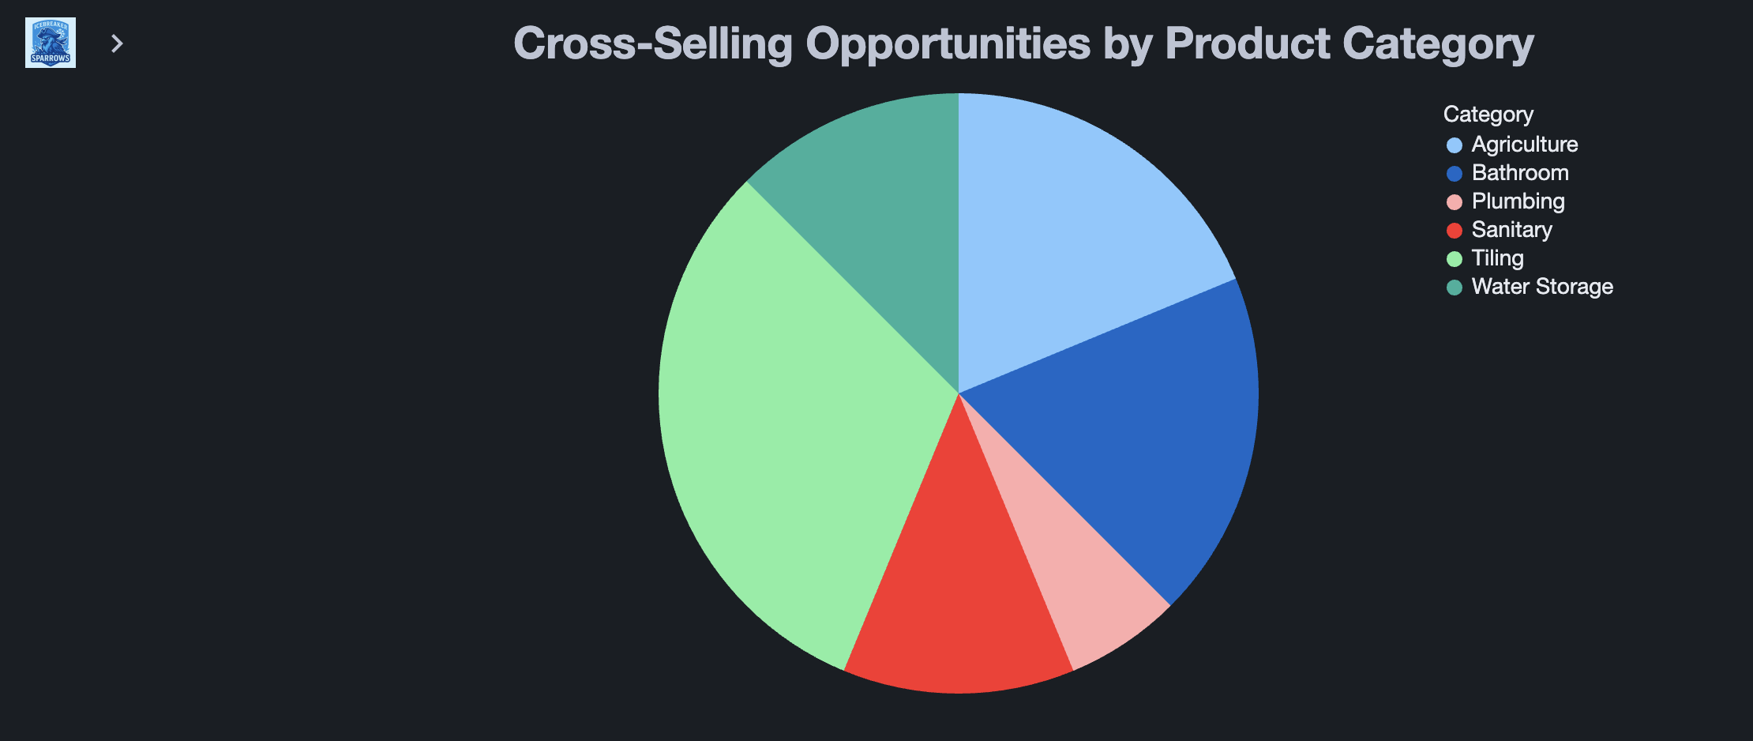
WORKING DEMO / OUTPUT
Screenshots

Slide 11
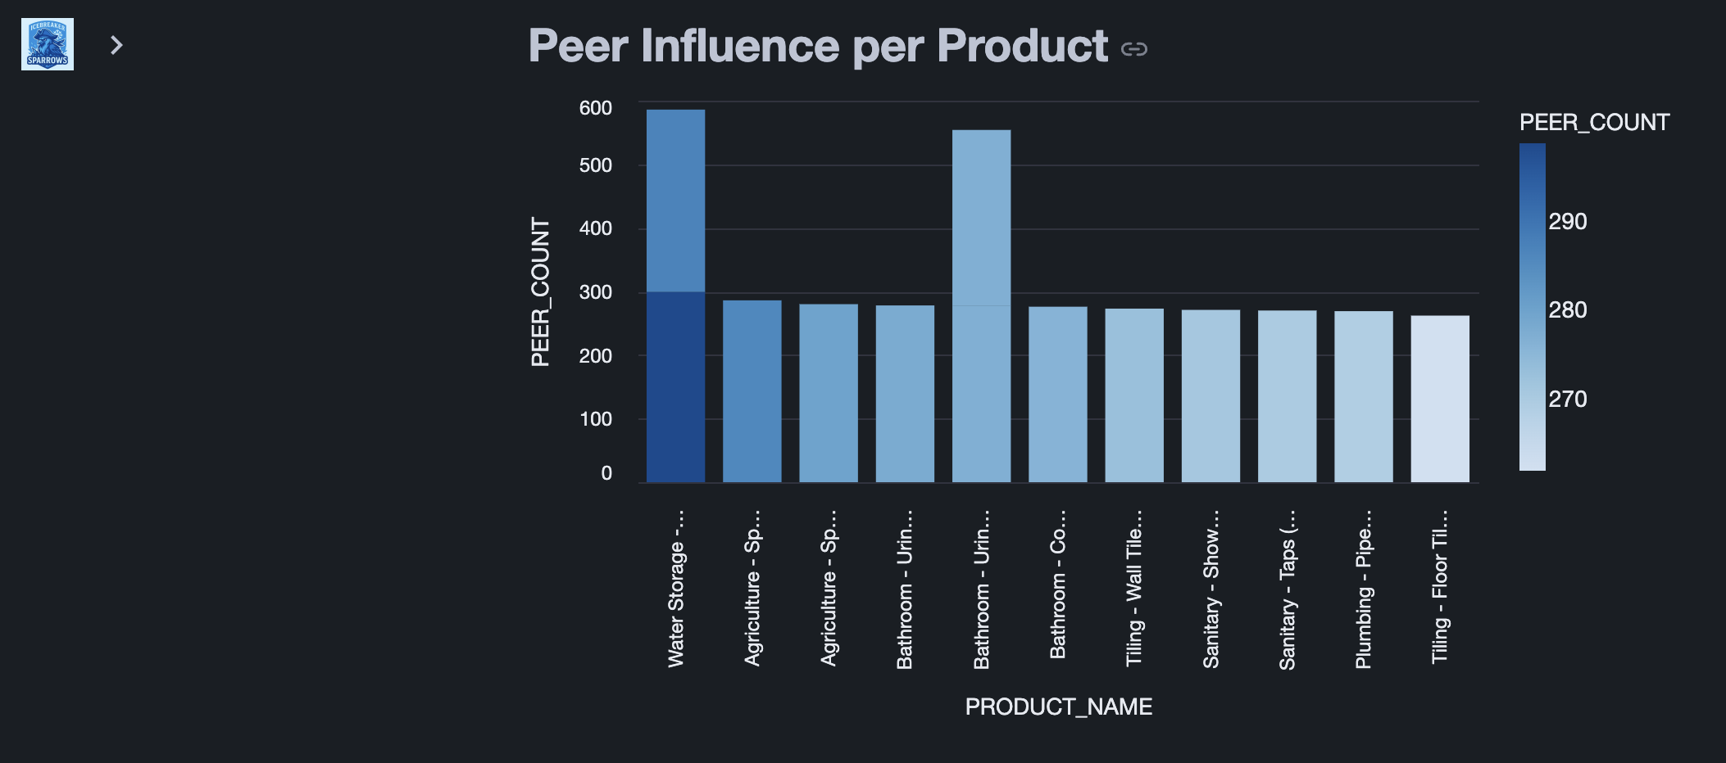
WORKING DEMO / OUTPUT
Screenshots

Slide 12
IMPACT POTENTIAL
What benefits can this solution drive at scale?
Revenue Growth
~8% increase in dealer sales via personalized recommendations
Efficiency Gains
~25% time saved for sales teams through automated product suggestions
~20% reduction in manual product discovery for dealers
Accuracy & Trust
Collaborative filtering ensures relevant, data-backed recommendations
Enhances dealer confidence and repeat purchase behavior
Cost Reduction
~10–15% reduction in excess inventory holding costs
Better demand alignment lowers working capital requirements

Slide 13
ADOPTION
Who stands to gain, and how?
Dealers: Receive tailored product suggestions, boosting sales and customer satisfaction.
Businesses: Improve supply chain efficiency and revenue through targeted recommendations.
Sales Teams: Focus on high-value opportunities with data-driven insights.
Would a real user adopt it?
Yes, dealers and sales managers would adopt it due to its intuitive Streamlit interface, real-time filtering, and actionable insights based on peer behavior and purchase history.

Slide 14
WHAT’S NEXT
What’s next if this were to be taken forward?
Enhance Model: Incorporate clustering (using DWH.CLUSTERING_FEATURES) for dealer segmentation.
Real Data Integration: Replace synthetic data with real sales data for production use.
Advanced Analytics: Add predictive models (e.g., demand forecasting) in Snowflake.
Expand Dashboard: Include more visualizations and export options in Streamlit.

Slide 15
THANK YOU

